Slide 1


Noida Institute of Engineering and Technology, Greater Noida
INTRODUCTION TO MACHINE LEARNING
Unit: 1
MACHINE LEARNING
ACSML0501
Ms. Sonia Arora
Assistant Professor
CSBS Department
B Tech 5TH Sem
Computer Science and Engineering (DATA SCIENCE)

Slide 2
Noida Institute of Engineering and Technology, Greater Noida
Introduction SONIA ARORA ,AP , Department of CSBS B.TECH, M.Tech AND PHD (P) in CSE with 11+ Years Teaching Experience
Areas of interest include image processing, machine learning, artificial intelligence and database systems.
Attended and Conducted Numerous National Level Workshops.
Published about 11 National and International Papers in reputed Journals and conferences.

Slide 3
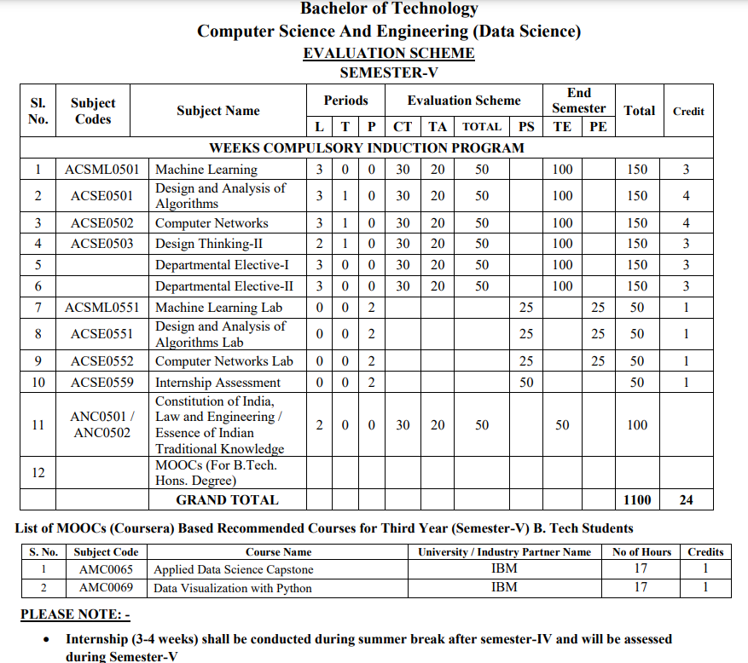
Evaluation Scheme

Slide 4
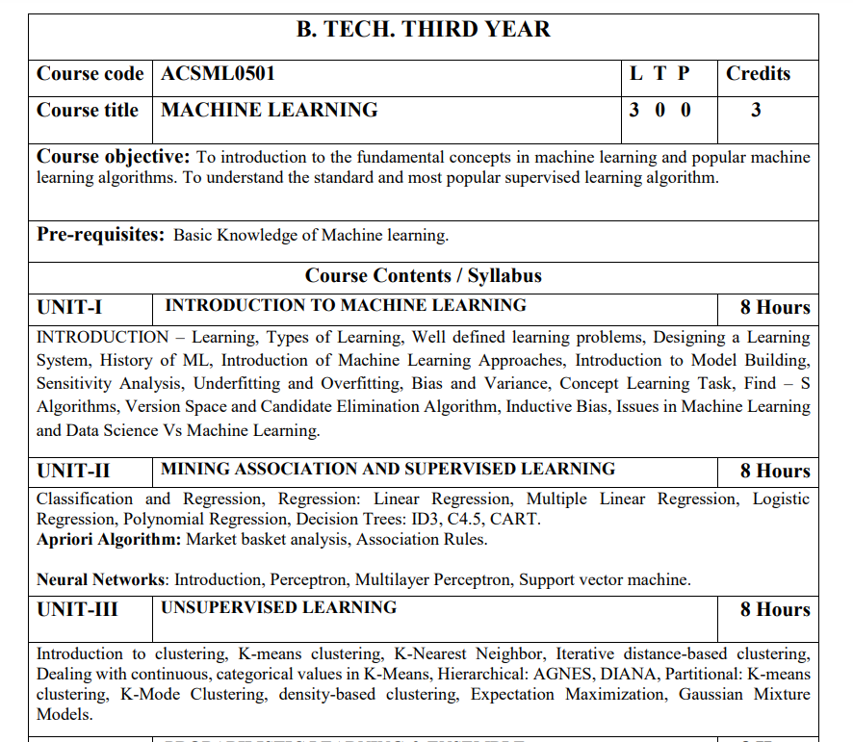
Subject Syllabus

Slide 5
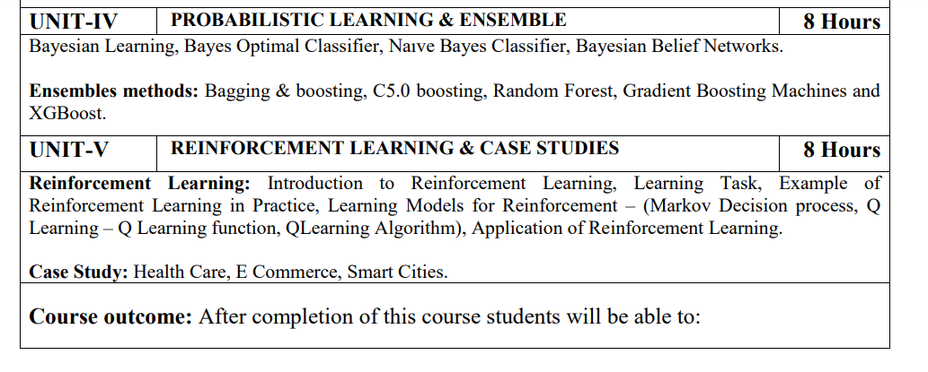
Subject Syllabus

Slide 6
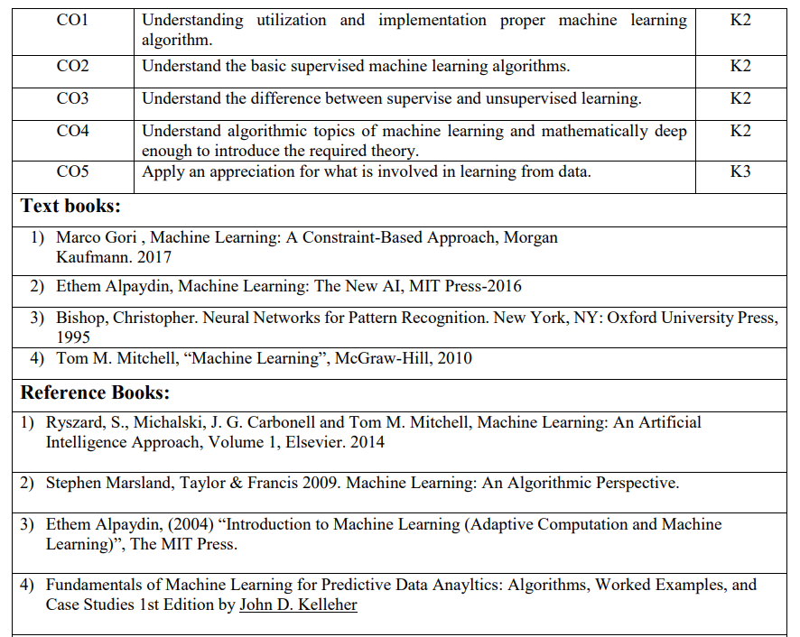
Text Books

Slide 7
Branch Wise Applications

Slide 8
Course Objective
To introduce students to the basic concepts of Machine Learning.
To develop skills of implementing machine learning for solving practical problems.
To gain experience of doing independent study and research related to Machine Learning

Slide 9
Course Outcome
At the end of the semester, student will be able to:
Course Outcomes (CO) | CO Description | Blooms’ Taxonomy
CO1 | Understanding utilization and implementation proper machine learning algorithm. | K2
CO2 | Understand the basic supervised machine learning algorithms. | K2
CO3 | Understand the difference between supervise and unsupervised learning. | K2
CO4 | Understand algorithmic topics of machine learning and mathematically deep enough to introduce the required theory. | K2
CO5 | Apply an appreciation for what is involved in learning from data. | K3

Slide 10
Program Outcome
1. Engineering knowledge:
2. Problem analysis:
3. Design/development of solutions:
4. Conduct investigations of complex problems:
5. Modern tool usage:
6. The engineer and society:
7. Environment and sustainability:
8. Ethics:
9. Individual and team work:
10. Communication:
11. Project management and finance:
12. Life-long learning

Slide 11
CO-PO and PSO Mapping
Correlation Matrix of CO with PO
CO.K | PO1 | PO2 | PO3 | PO4 | PO5 | PO6 | PO7 | PO8 | PO9 | PO10 | PO11 | PO12
ACSML0601.1 | 3 | 2 | 2 | 1 | 2 | 2 | - | - | - | 1 | - | -
ACSML0601.2 | 3 | 2 | 2 | 3 | 2 | 2 | 1 | - | 2 | 1 | 1 | 2
ACSML0601.3 | 2 | 2 | 2 | 2 | 2 | 2 | 2 | 1 | 1 | - | 1 | 3
ACSML0601.4 | 3 | 3 | 1 | 3 | 1 | 1 | 2 | - | 2 | 1 | 1 | 2
ACSML0601.5 | 3 | 2 | 1 | 2 | 1 | 2 | 1 | 1 | 2 | 1 | 1 | 1
AVG | 2.8 | 2.2 | 1.6 | 2.2 | 1.6 | 1.8 | 1.2 | 0.4 | 1.4 | 0.8 | 0.8 | 1.6

Slide 12
Program Specific Outcomes
PSO1-Apply Artificial Intelligence and its applications to design intelligent systems for the betterment of society.
PSO2-Develop AI-based innovative solutions demonstrating research, entrepreneurship, professional ethics, and communication skills.
PSO3-Demonstrate competency in AI by working in a team and engaging in life-long learning.

Slide 13
CO-PO and PSO Mapping
Matrix of CO/PSO:
 | PSO1 | PSO2 | PSO3
ACSML0601.1 | 3 | 2 | 3
ACSML0601.2 | 3 | 2 | 2
ACSML0601.3 | 3 | 2 | 3
ACSML0601.4 | 2 | 1 | 1
ACSML0601.5 | 2 | 2 | 1
AVG | 2.6 | 1.8 | 2

Slide 14
Program Educational Objectives
PEO1-Engage in successful professional practices in the area of Artificial Intelligence and pursue higher education and research.
PEO2-Demonstrate effective leadership and communicate as an individual and as a team in the workspace and society.
PEO3-Pursue life-long learning in developing AI-based innovative solutions for the betterment of society.

Slide 15
Result Analysis
ML Result of 2021-22: 96.00%
ML Result of 2022-23: 95.80%

Slide 16

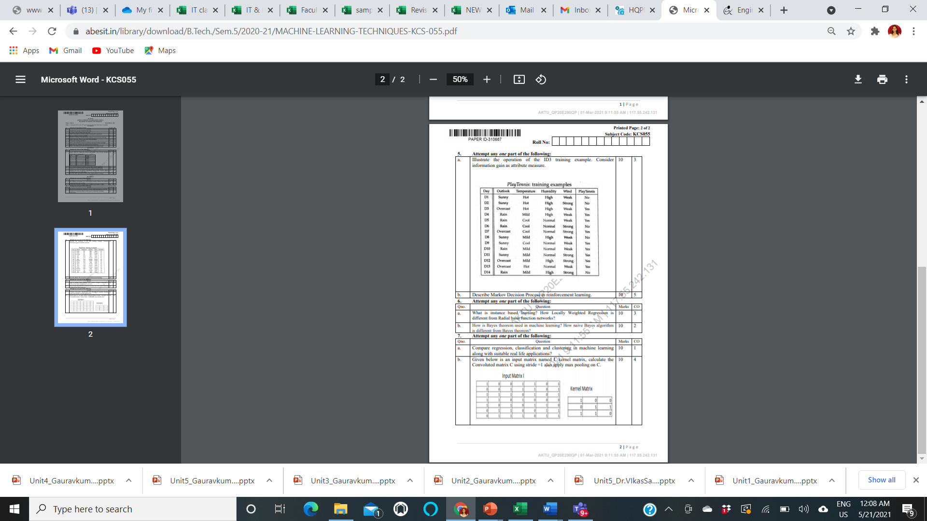
End Semester Question Paper Template

Slide 17
Prerequisite
Prerequisites:
Statistics.
Linear Algebra.
Calculus.
Probability.
Programming Languages.

Slide 18
Brief Introduction to Subject
https://www.youtube.com/watch?v=ukzFI9rgwfU&pp=ygUgaW50cm9kdWN0aW9uIHRvIG1hY2hpbmUgbGVhcm5pbmc%3D

Slide 19
Topic Mapping with Course Outcome
Topics | Course outcome
Learning, Types of Learning, Well defined learning problems. Designing a Learning System. Concept Learning Introduction of Machine Learning Approaches –Issues in Machine Learning. Data Science Vs Machine Learning; | CO1 CO1 CO1 CO1 CO1

Slide 20
Lecture Plan

Slide 21
Lecture Plan

Slide 22
Lecture Plan

Slide 23
Lecture Plan

Slide 24
Lecture Plan

Slide 25
Unit 1 Content:
INTRODUCTION – Learning,
Types of Learning,
Well defined learning problems,
Designing a Learning System,
History of ML,
Introduction of Machine Learning Approaches,
Introduction to Model Building,
Sensitivity Analysis,
Underfitting and Overfitting,
Bias and Variance,
Concept Learning Task,
Issues in Machine Learning and Data Science Vs Machine Learning.

Slide 26
Unit Objective
The objective of the Unit 1:
1. To understand the basics of machine learning.
2. A clear concept of Learning and learning systems.
3. Brief History of ML.
4. Use of various approaches of Machine learning.
5. understand the difference between Data Science and Machine learning.

Slide 27
Topic Objective
Student will be able to understand
Learning
Types of Learning,
Well defined learning problems,
Designing a Learning System

Slide 28

Introduction
Top minds in machine learning predict where AI is going in 2021 and Beyond
AI is no longer poised to change the world someday; it’s changing the world now.

Slide 29

Introduction
Soumith Chintala
Director, principal engineer, and creator of PyTorch
Depending on how you gauge it, PyTorch is the most popular machine learning framework in the world today.
A derivative of the Torch open source framework introduced in 2002, PyTorch became available in 2015 and is growing steadily in extensions and libraries.

Slide 30
Introduction
Soumith Chintala
Director, principal engineer, and creator of PyTorch
“I actually don’t think we’ve had a groundbreaking thing … since Transformer, basically. We had ConvNets in 2012 that reached prime time, and Transformer in 2017 or something. That’s my personal opinion,”
Chintala also believes the evolution of machine learning frameworks like PyTorch and Google’s TensorFlow — the overwhelming favorites among ML practitioners today — have changed how researchers explore ideas and do their jobs.

Slide 31

Introduction
Celeste Kidd
Developmental psychologist at the
University of California, Berkeley
Celeste Kidd is director of Kidd Lab at the University of California, Berkeley, where she and her team explore how kids learn.
“Human babies don’t get tagged data sets, yet they manage just fine, and it’s important for us to understand how that happens,” she said.
Last month, Kidd delivered the opening keynote address at the Neural Information Processing Systems (NeurIPS) conference, the largest annual AI research conference in the world. Her talk focused on how human brains hold onto stubborn beliefs, attention systems, and Bayesian statistics.

Slide 32
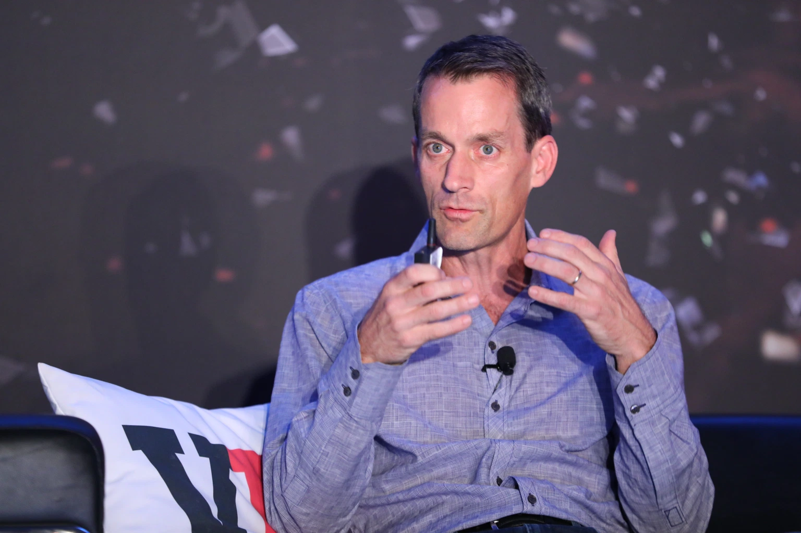
Introduction
Jeff Dean
Google AI chief
Dean has led Google AI for nearly two years now, but he’s been at Google for two decades and is the architect of many of the company’s early search and distributed network algorithms and an early member of Google Brain.
Dean spoke with VentureBeat last month at NeurIPS, where he delivered talks on machine learning for ASIC semiconductor design and ways the AI community can address climate change, which he said is the most important issue of our time. In his talk about climate change, Dean discussed the idea that AI can strive to become a zero-carbon industry and that AI can be used to help change human behavior.

Slide 33

Introduction
Anima Anandkumar
Nvidia machine learning research director
Anandkumar sees numerous challenges for the AI community in 2020, like the need to create models made especially for specific industries in tandem with domain experts. Policymakers, individuals, and the AI community will also need to grapple with issues of representation and the challenge of ensuring data sets used to train models account for different groups of people.

Slide 34
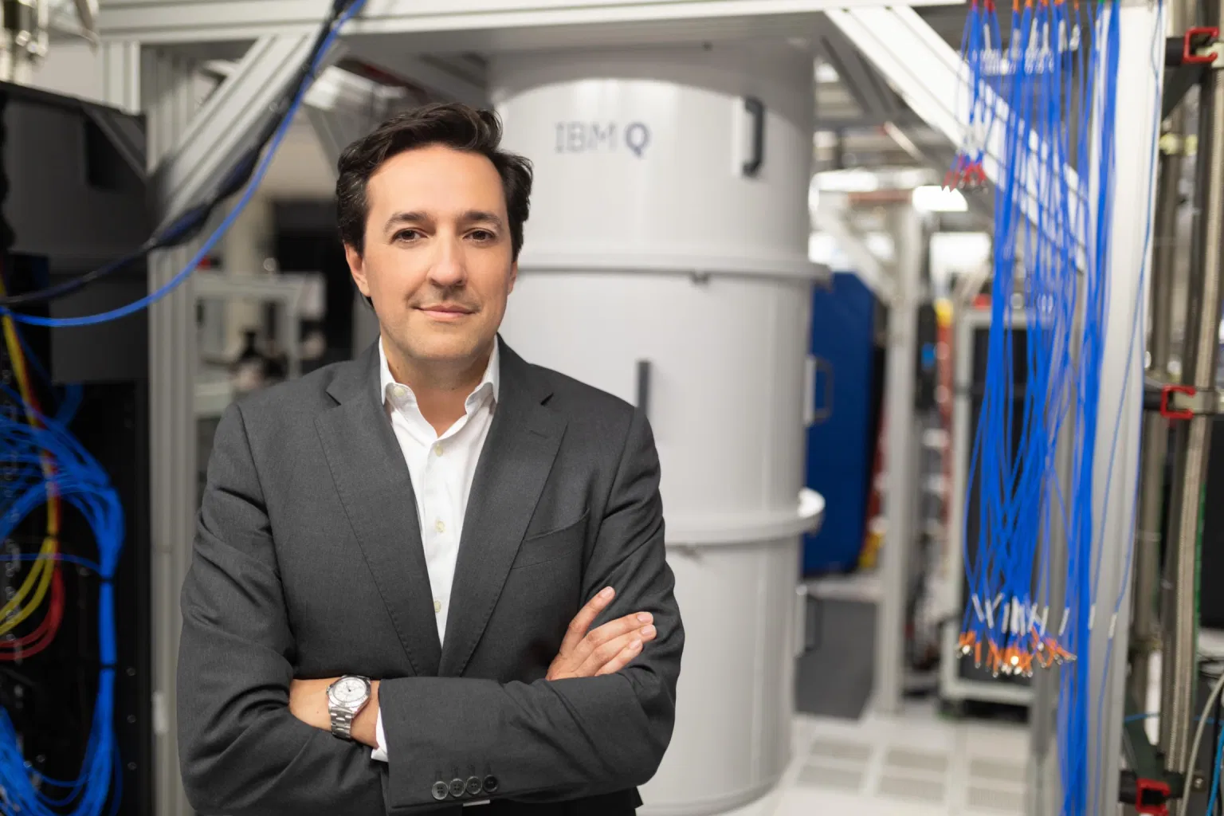
Introduction
Dario Gil
IBM Research director
Gil heads a group of researchers actively advising the White House and enterprises around the world. He believes major leaps forward in 2019 include progress around generative models and the increasing quality with which plausible language can be generated.

Slide 35
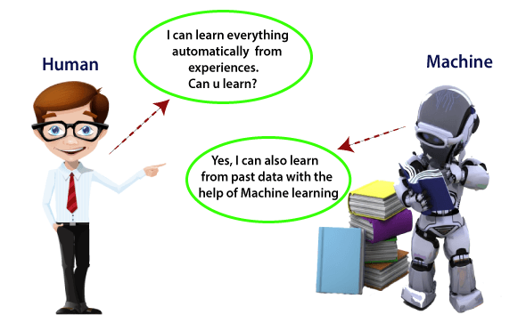
Introduction to Machine Learning
What is Machine Learning

Slide 36
Introduction to Machine Learning

Slide 37
Introduction to Machine Learning

Slide 38
Introduction to Machine Learning

Slide 39
Introduction to Machine Learning

Slide 40
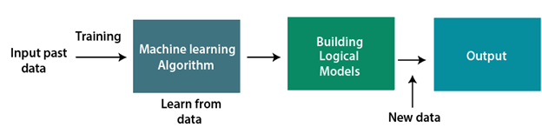
Introduction to Machine Learning
How does Machine Learning work:
A machine learning system builds prediction models, learns from previous data, and predicts the output of new data whenever it receives it.
The amount of data helps to build a better model that accurately predicts the output, which in turn affects the accuracy of the predicted output.
The Machine Learning algorithm's operation is depicted in the following block diagram:

Slide 41
Introduction to Machine Learning
Features of Machine Learning:
Machine learning uses data to detect various patterns in a given dataset.
It can learn from past data and improve automatically.
It is a data-driven technology.
Machine learning is much similar to data mining as it also deals with the huge amount of the data.

Slide 42
Introduction to Machine Learning

Slide 43
Introduction to Machine Learning

Slide 44
Introduction to Machine Learning

Slide 45
Introduction to Machine Learning

Slide 46
Introduction to Machine Learning

Slide 47
Introduction to Machine Learning

Slide 48
Introduction to Machine Learning

Slide 49
Introduction to Machine Learning

Slide 50
Type Of Learning

Slide 51
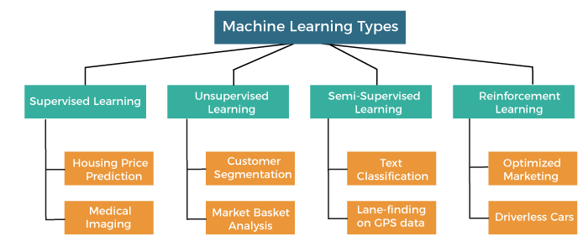
Type Of Learning
Based on the methods and way of learning, machine learning is divided into mainly four types, which are:
Supervised Machine Learning
Unsupervised Machine Learning
Semi-Supervised Machine Learning
Reinforcement Learning

Slide 52
Type Of Learning
Supervised Learning:
Supervised machine learning is a type of machine learning where the algorithm is trained on labeled data, meaning that the data is already categorized or classified.
The goal of the algorithm is to learn from the labeled data and make predictions on new, unseen data.
In supervised learning, the algorithm is trained to map inputs to outputs based on the labeled data.
The algorithm learns to identify patterns and relationships between the inputs and outputs, and uses this knowledge to make predictions on new data.

Slide 53
Type Of Learning
Categories of Supervised Machine Learning
Supervised machine learning can be classified into two types of problems, which are given below:
Classification
Regression

Slide 54
Type Of Learning (Supervised Leraning)
a)Classification:
Classification algorithms are used to solve the classification problems in which the output variable is categorical, such as "Yes" or No, Male or Female, Red or Blue, etc.
The classification algorithms predict the categories present in the dataset.
Some real-world examples of classification algorithms are Spam Detection, Email filtering, etc.
Some popular classification algorithms are given below:
Random Forest Algorithm
Decision Tree Algorithm
Logistic Regression Algorithm
Support Vector Machine Algorithm

Slide 55
Type Of Learning (Supervised Leraning)
b) Regression
Regression algorithms are used to solve regression problems in which there is a linear relationship between input and output variables.
These are used to predict continuous output variables, such as market trends, weather prediction, etc.
Some popular Regression algorithms are given below:
Simple Linear Regression Algorithm
Multivariate Regression Algorithm
Decision Tree Algorithm
Lasso Regression

Slide 56
Type Of Learning (Supervised Leraning)
Advantages and Disadvantages of Supervised Learning
Advantages:
Since supervised learning work with the labelled dataset so we can have an exact idea about the classes of objects.
These algorithms are helpful in predicting the output on the basis of prior experience.
Disadvantages:
These algorithms are not able to solve complex tasks.
It may predict the wrong output if the test data is different from the training data.
It requires lots of computational time to train the algorithm.

Slide 57
Type Of Learning (Supervised Leraning)
Applications of Supervised Learning:
Image Segmentation: In this process, image classification is performed on different image data with pre-defined labels.
Medical Diagnosis: It is done by using medical images and past labelled data with labels for disease conditions. With such a process, the machine can identify a disease for the new patients.
Fraud Detection - Supervised Learning classification algorithms are used for identifying fraud transactions, fraud customers, etc. It is done by using historic data to identify the patterns that can lead to possible fraud.
Spam detection - In spam detection & filtering, classification algorithms are used. These algorithms classify an email as spam or not spam. The spam emails are sent to the spam folder.
Speech Recognition - Supervised learning algorithms are also used in speech recognition. The algorithm is trained with voice data, and various identifications can be done using the same, such as voice-activated passwords, voice commands, etc.

Slide 58
Type Of Learning (Unsupervised Leraning)
2. Unsupervised Machine Learning
Unsupervised learning is different from the Supervised learning technique; as its name suggests, there is no need for supervision.
It means, in unsupervised machine learning, the machine is trained using the unlabeled dataset, and the machine predicts the output without any supervision.
In unsupervised learning, the models are trained with the data that is neither classified nor labelled, and the model acts on that data without any supervision.
The main aim of the unsupervised learning algorithm is to group or categories the unsorted dataset according to the similarities, patterns, and differences.
Machines are instructed to find the hidden patterns from the input dataset.

Slide 59
Type Of Learning (Unsupervised Leraning)
Categories of Unsupervised Machine Learning
Unsupervised Learning can be further classified into two types, which are given below:
Clustering
Association

Slide 60
Type Of Learning (Unsupervised Leraning)
1) Clustering
The clustering technique is used when we want to find the inherent groups from the data.
It is a way to group the objects into a cluster such that the objects with the most similarities remain in one group and have fewer or no similarities with the objects of other groups.
An example of the clustering algorithm is grouping the customers by their purchasing behaviour.
Some of the popular clustering algorithms are given below:
K-Means Clustering algorithm
Mean-shift algorithm
DBSCAN Algorithm
Principal Component Analysis
Independent Component Analysis

Slide 61
Type Of Learning (Unsupervised Leraning)
2) Association:
Association rule learning is an unsupervised learning technique, which finds interesting relations among variables within a large dataset.
The main aim of this learning algorithm is to find the dependency of one data item on another data item and map those variables accordingly so that it can generate maximum profit.
This algorithm is mainly applied in Market Basket analysis, Web usage mining, continuous production, etc.
Some popular algorithms of Association rule learning are Apriori Algorithm, Eclat, FP-growth algorithm.

Slide 62
Type Of Learning (Unsupervised Leraning)
Advantages and Disadvantages of Unsupervised Learning Algorithm
Advantages:
These algorithms can be used for complicated tasks compared to the supervised ones because these algorithms work on the unlabeled dataset.
Unsupervised algorithms are preferable for various tasks as getting the unlabeled dataset is easier as compared to the labelled dataset.
Disadvantages:
The output of an unsupervised algorithm can be less accurate as the dataset is not labelled, and algorithms are not trained with the exact output in prior.
Working with Unsupervised learning is more difficult as it works with the unlabelled dataset that does not map with the output.

Slide 63
Type Of Learning (Unsupervised Leraning)
Applications of Unsupervised Learning:
Network Analysis: Unsupervised learning is used for identifying plagiarism and copyright in document network analysis of text data for scholarly articles.
Recommendation Systems: Recommendation systems widely use unsupervised learning techniques for building recommendation applications for different web applications and e-commerce websites.
Anomaly Detection: Anomaly detection is a popular application of unsupervised learning, which can identify unusual data points within the dataset. It is used to discover fraudulent transactions.
Singular Value Decomposition: Singular Value Decomposition or SVD is used to extract particular information from the database. For example, extracting information of each user located at a particular location.

Slide 64
Type Of Learning (Semi-supervised Leraning)
Semi-Supervised Learning
Semi-Supervised learning is a type of Machine Learning algorithm that lies between Supervised and Unsupervised machine learning.
It represents the intermediate ground between Supervised (With Labelled training data) and Unsupervised learning (with no labelled training data) algorithms and uses the combination of labelled and unlabeled datasets during the training period.
Although Semi-supervised learning is the middle ground between supervised and unsupervised learning and operates on the data that consists of a few labels, it mostly consists of unlabeled data.
As labels are costly, but for corporate purposes, they may have few labels.
It is completely different from supervised and unsupervised learning as they are based on the presence & absence of labels.

Slide 65
Type Of Learning (Semi-supervised Leraning)
To overcome the drawbacks of supervised learning and unsupervised learning algorithms, the concept of Semi-supervised learning is introduced.
The main aim of semi-supervised learning is to effectively use all the available data, rather than only labelled data like in supervised learning.
Initially, similar data is clustered along with an unsupervised learning algorithm, and further, it helps to label the unlabeled data into labelled data.
It is because labelled data is a comparatively more expensive acquisition than unlabeled data.

Slide 66
Type Of Learning (Semi-supervised Leraning)
Advantages and disadvantages of Semi-supervised Learning:
Advantages:
It is simple and easy to understand the algorithm.
It is highly efficient.
It is used to solve drawbacks of Supervised and Unsupervised Learning algorithms.
Disadvantages:
Iterations results may not be stable.
We cannot apply these algorithms to network-level data.
Accuracy is low.

Slide 67
Type Of Learning (Reinforcement Leraning)
4. Reinforcement Learning:
Reinforcement learning works on a feedback-based process, in which an AI agent (A software component) automatically explore its surrounding by hitting & trail, taking action, learning from experiences, and improving its performance.
Agent gets rewarded for each good action and get punished for each bad action; hence the goal of reinforcement learning agent is to maximize the rewards.
In reinforcement learning, there is no labelled data like supervised learning, and agents learn from their experiences only.

Slide 68
Type Of Learning (Reinforcement Leraning)
The reinforcement learning process is similar to a human being; for example, a child learns various things by experiences in his day-to-day life.
An example of reinforcement learning is to play a game, where the Game is the environment, moves of an agent at each step define states, and the goal of the agent is to get a high score. Agent receives feedback in terms of punishment and rewards.
Due to its way of working, reinforcement learning is employed in different fields such as Game theory, Operation Research, Information theory, multi-agent systems.
A reinforcement learning problem can be formalized using Markov Decision Process(MDP).
In MDP, the agent constantly interacts with the environment and performs actions; at each action, the environment responds and generates a new state.

Slide 69
Type Of Learning (Reinforcement Leraning)
Categories of Reinforcement Learning:
Reinforcement learning is categorized mainly into two types of methods/algorithms:
Positive Reinforcement Learning: Positive reinforcement learning specifies increasing the tendency that the required behaviour would occur again by adding something. It enhances the strength of the behaviour of the agent and positively impacts it.
Negative Reinforcement Learning: Negative reinforcement learning works exactly opposite to the positive RL. It increases the tendency that the specific behaviour would occur again by avoiding the negative condition.

Slide 70
Type Of Learning (Reinforcement Leraning)
Real-world Use cases of Reinforcement Learning
Video Games: RL algorithms are much popular in gaming applications. It is used to gain super-human performance. Some popular games that use RL algorithms are AlphaGO and AlphaGO Zero.
Resource Management: The "Resource Management with Deep Reinforcement Learning" paper showed that how to use RL in computer to automatically learn and schedule resources to wait for different jobs in order to minimize average job slowdown.
Robotics: RL is widely being used in Robotics applications. Robots are used in the industrial and manufacturing area, and these robots are made more powerful with reinforcement learning. There are different industries that have their vision of building intelligent robots using AI and Machine learning technology.
Text Mining Text-mining, one of the great applications of NLP, is now being implemented with the help of Reinforcement Learning by Salesforce company.

Slide 71
Type Of Learning (Reinforcement Leraning)
Advantages and Disadvantages of Reinforcement Learning:
Advantages
It helps in solving complex real-world problems which are difficult to be solved by general techniques.
The learning model of RL is similar to the learning of human beings; hence most accurate results can be found.
Helps in achieving long term results.
Disadvantage
RL algorithms are not preferred for simple problems.
RL algorithms require huge data and computations.
Too much reinforcement learning can lead to an overload of states which can weaken the results.

Slide 72
Well Defined Learning Problems
Well Posed Learning Problem –
A computer program is said to learn from experience E in context to some task T and some performance measure P, if its performance on T, as was measured by P, upgrades with experience E.
Any problem can be segregated as well-posed learning problem if it has three traits –
Task
Performance Measure
Experience
Certain examples that efficiently defines the well-posed learning problem are –
1. To better filter emails as spam or not
Task – Classifying emails as spam or not
Performance Measure – The fraction of emails accurately classified as spam or not spam
Experience – Observing you label emails as spam or not spam

Slide 73
Well Defined Learning Problems
2. A checkers learning problem
Task – Playing checkers game
Performance Measure – percent of games won against opposer
Experience – playing implementation games against itself
3. Handwriting Recognition Problem
Task – Acknowledging handwritten words within portrayal
Performance Measure – percent of words accurately classified
Experience – a directory of handwritten words with given classifications
4. A Robot Driving Problem
Task – driving on public four-lane highways using sight scanners
Performance Measure – average distance progressed before a fallacy
Experience – order of images and steering instructions noted down while observing a human driver
5. Fruit Prediction Problem
Task – forecasting different fruits for recognition
Performance Measure – able to predict maximum variety of fruits
Experience – training machine with the largest datasets of fruits images

Slide 74
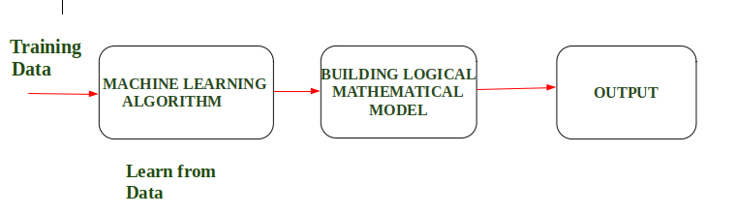
Designing a Learning System
Designing a Learning System in Machine Learning :
According to Tom Mitchell, “A computer program is said to be learning from experience (E), with respect to some task (T).
Thus, the performance measure (P) is the performance at task T, which is measured by P, and it improves with experience E.”
Example: In Spam E-Mail detection,
Task, T: To classify mails into Spam or Not Spam.
Performance measure, P: Total percent of mails being correctly classified as being “Spam” or “Not Spam”.
Experience, E: Set of Mails with label “Spam”

Slide 75
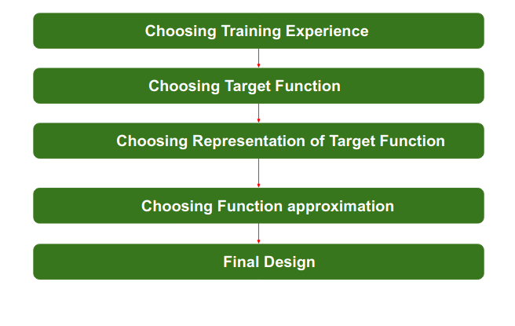
Designing a Learning System
Steps for Designing Learning System are:

Slide 76
Designing a Learning System
Step 1) Choosing the Training Experience: The very important and first task is to choose the training data or training experience which will be fed to the Machine Learning Algorithm. It is important to note that the data or experience that we fed to the algorithm must have a significant impact on the Success or Failure of the Model. So Training data or experience should be chosen wisely.
Step 2- Choosing target function: The next important step is choosing the target function. It means according to the knowledge fed to the algorithm the machine learning will choose NextMove function which will describe what type of legal moves should be taken. For example : While playing chess with the opponent, when opponent will play then the machine learning algorithm will decide what be the number of possible legal moves taken in order to get success.

Slide 77
Designing a Learning System
Step 3- Choosing Representation for Target function: When the machine algorithm will know all the possible legal moves the next step is to choose the optimized move using any representation i.e. using linear Equations, Hierarchical Graph Representation, Tabular form etc. The NextMove function will move the Target move like out of these move which will provide more success rate. For Example : while playing chess machine have 4 possible moves, so the machine will choose that optimized move which will provide success to it.
Step 4- Choosing Function Approximation Algorithm: An optimized move cannot be chosen just with the training data. The training data had to go through with set of example and through these examples the training data will approximates which steps are chosen and after that machine will provide feedback on it. For Example : When a training data of Playing chess is fed to algorithm so at that time it is not machine algorithm will fail or get success and again from that failure or success it will measure while next move what step should be chosen and what is its success rate.

Slide 78
Designing a Learning System
Step 5- Final Design: The final design is created at last when system goes from number of examples , failures and success , correct and incorrect decision and what will be the next step etc. Example: DeepBlue is an intelligent computer which is ML-based won chess game against the chess expert Garry Kasparov, and it became the first computer which had beaten a human chess expert.

Slide 79
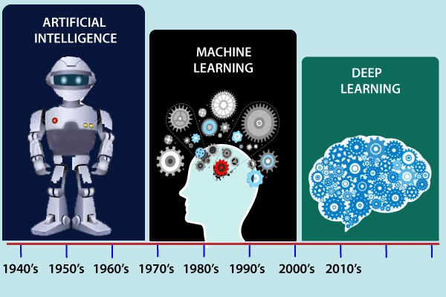
History of Machine Learning (CO1)

Slide 80
History of Machine Learning (CO1)
The early history of Machine Learning (Pre-1940):
1834: In 1834, Charles Babbage, the father of the computer, conceived a device that could be programmed with punch cards. However, the machine was never built, but all modern computers rely on its logical structure.
1936: In 1936, Alan Turing gave a theory that how a machine can determine and execute a set of instructions.
The era of stored program computers:
1940: In 1940, the first manually operated computer, "ENIAC" was invented, which was the first electronic general-purpose computer. After that stored program computer such as EDSAC in 1949 and EDVAC in 1951 were invented.
1943: In 1943, a human neural network was modeled with an electrical circuit. In 1950, the scientists started applying their idea to work and analyzed how human neurons might work.

Slide 81
History of Machine Learning (CO1)
Computer machinery and intelligence:
1950: In 1950, Alan Turing published a seminal paper, "Computer Machinery and Intelligence," on the topic of artificial intelligence. In his paper, he asked, "Can machines think?"
Machine intelligence in Games:
1952: Arthur Samuel, who was the pioneer of machine learning, created a program that helped an IBM computer to play a checkers game. It performed better more it played.
1959: In 1959, the term "Machine Learning" was first coined by Arthur Samuel.
The first "AI" winter:
The duration of 1974 to 1980 was the tough time for AI and ML researchers, and this duration was called as AI winter.
In this duration, failure of machine translation occurred, and people had reduced their interest from AI, which led to reduced funding by the government to the researches.

Slide 82
History of Machine Learning (CO1)
Machine Learning from theory to reality
1959: In 1959, the first neural network was applied to a real-world problem to remove echoes over phone lines using an adaptive filter.
1985: In 1985, Terry Sejnowski and Charles Rosenberg invented a neural network NETtalk, which was able to teach itself how to correctly pronounce 20,000 words in one week.
1997: The IBM's Deep blue intelligent computer won the chess game against the chess expert Garry Kasparov, and it became the first computer which had beaten a human chess expert.

Slide 83
History of Machine Learning (CO1)
Machine Learning at 21st century
2006: In the year 2006, computer scientist Geoffrey Hinton has given a new name to neural net research as "deep learning," and nowadays, it has become one of the most trending technologies.
2012: In 2012, Google created a deep neural network which learned to recognize the image of humans and cats in YouTube videos.
2014: In 2014, the Chabot "Eugen Goostman" cleared the Turing Test. It was the first Chabot who convinced the 33% of human judges that it was not a machine.
2014: DeepFace was a deep neural network created by Facebook, and they claimed that it could recognize a person with the same precision as a human can do.
2016: AlphaGo beat the world's number second player Lee sedol at Go game. In 2017 it beat the number one player of this game Ke Jie.
2017: In 2017, the Alphabet's Jigsaw team built an intelligent system that was able to learn the online trolling. It used to read millions of comments of different websites to learn to stop online trolling.

Slide 84
History of Machine Learning (CO1)
Machine Learning at present:
Now machine learning has got a great advancement in its research, and it is present everywhere around us, such as self-driving cars, Amazon Alexa, Catboats, recommender system, and many more. It includes Supervised, unsupervised, and reinforcement learning with clustering, classification, decision tree, SVM algorithms, etc.
Modern machine learning models can be used for making various predictions, including weather prediction, disease prediction, stock market analysis, etc.

Slide 85

Introduction of Machine Learning Approaches
A Neural Network
A neural network is a processing device, either an algorithm or an actual hardware, whose design was inspired by the design and functioning of animal brains and components thereof.
The neural networks have ability to learn by example, which makes them very flexible and powerful.
These networks are also well suited for real-time systems because of their fast response and computational times which are because of their parallel architecture.

Slide 86
Introduction of Machine Learning Approaches
Artificial Neural Network: Definition:
An artificial neural network (ANN) may be defined as an information processing model that is inspired by the way biological nervous systems, such as the brain, process information.
This model tries to replicate only the most basic functions of the brain.
The key element of ANN is the novel structure of its information processing system.
An ANN is composed of a large number of highly interconnected processing elements (neurons) working in unison to solve specific problems.
Artificial neural networks, like people, learn by example.

Slide 87
Introduction of Machine Learning Approaches
Advantages of Neural Networks:
Adaptive learning: An ANN is endowed with the ability to learn how to do tasks based on the data given for training or initial experience.
Self-organization: An ANN can create its own organization or representation of the information it receives during learning time.
Real-time operation: ANN computations may be carried out in parallel. Special hardware devices are being designed and manufactured to rake advantage of this capability of ANNs.
Fault tolerance via redundant information coding: Partial destruction of a neural network leads to the corresponding degradation of performance. However, some network capabilities may be retrained even after major network damage.

Slide 88
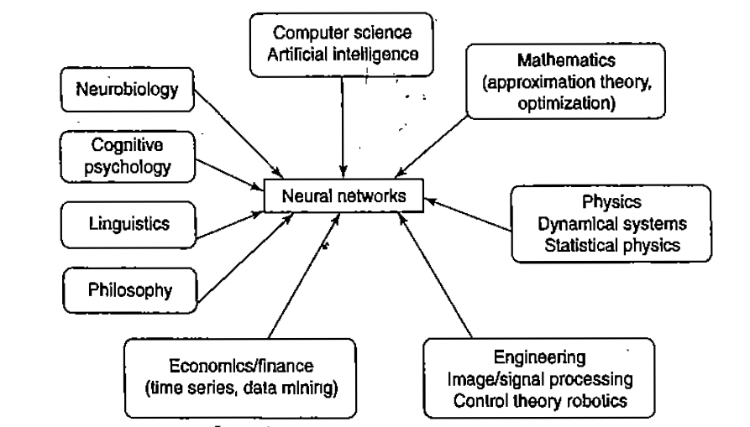
Introduction of Machine Learning Approaches

Slide 89
Introduction of Machine Learning Approaches
Application Scope of Neural Networks:
Air traffic control.
Animal behavior, predator/prey relationships and population cycles.
Appraisal and valuation of property, buildings, automobiles, machinery, etc.
Betting on horse races, stock markets, sporting events, etc.
Criminal sentencing could be predicted using a large sample of crime details as input and the resulting sentence as output.
Complex physical and chemical processes that may involve the interaction of numerous (possibly unknown) mathematical formulas could be modeled heuristically using a neural network.
Echo patterns from sonar, radar, seismic and magnetic instruments could be used to predict their targets.

Slide 90
Neural Networks
An artificial neural network (ANN) is an efficient information processing system which resembles in characteristics with a biological neural network.
ANNs possess large number of highly interconnected processing elements called nodes or units or neuron, which usually operate in parallel and are configured in regular architectures.
Each neuron is connected with the other by a connection link.
Each connection link is associated with weights which contain information about input signals.
This information is used by the neuron to solve a particular problem.

Slide 91
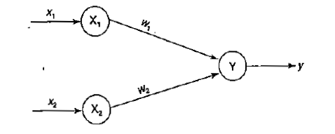
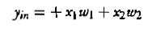
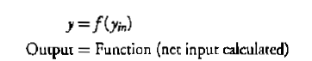
Neural Networks
To depict the basic operation of a neural net, consider a set of neurons, say X1 and X2, transmitting signals to another neuron, Y.
Here X1 and X2 are input neurons, which transmit signals, and Y is the output neuron, which receives signals.
Input neurons X1 and X2 are connected to the output neuron Y, over a weighted interconnection links (W1 and W2).
Activation Function

Slide 92
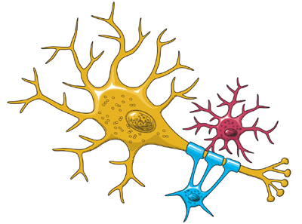
Biological Neural Networks
A nerve cell neuron is a special biological cell that processes information.
According to an estimation, there are huge number of neurons, approximately 10¹¹ with numerous interconnections, approximately 10¹⁵.

Slide 93
Biological Neural Networks
The central nervous system (which includes the brain and spinal cord) is made up of two basic types of cells:
neurons (1) and glia (4) & (6).
Glia outnumber neurons in some parts of the brain, but neurons are the key players in the brain.
Neurons are information messengers.
They use electrical impulses and chemical signals to transmit information between different areas of the brain, and between the brain and the rest of the nervous system.
Everything we think and feel and do would be impossible without the work of neurons and their support cells, the glial cells called astrocytes (4) and oligodendrocytes (6).

Slide 94
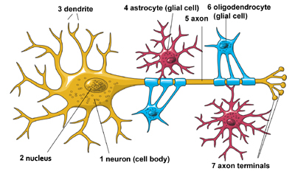
Biological Neural Networks
The Architecture of Neuron

Slide 95
Biological Neural Networks
Neurons have three basic parts: a cell body and two extensions called an axon (5) and a dendrite (3).
Within the cell body is a nucleus (2), which controls the cell’s activities and contains the cell’s genetic material.
The axon looks like a long tail and transmits messages from the cell.
Dendrites look like the branches of a tree and receive messages for the cell.
Neurons communicate with each other by sending chemicals, called neurotransmitters, across a tiny space, called a synapse, between the axons and dendrites of adjacent neurons.

Slide 96
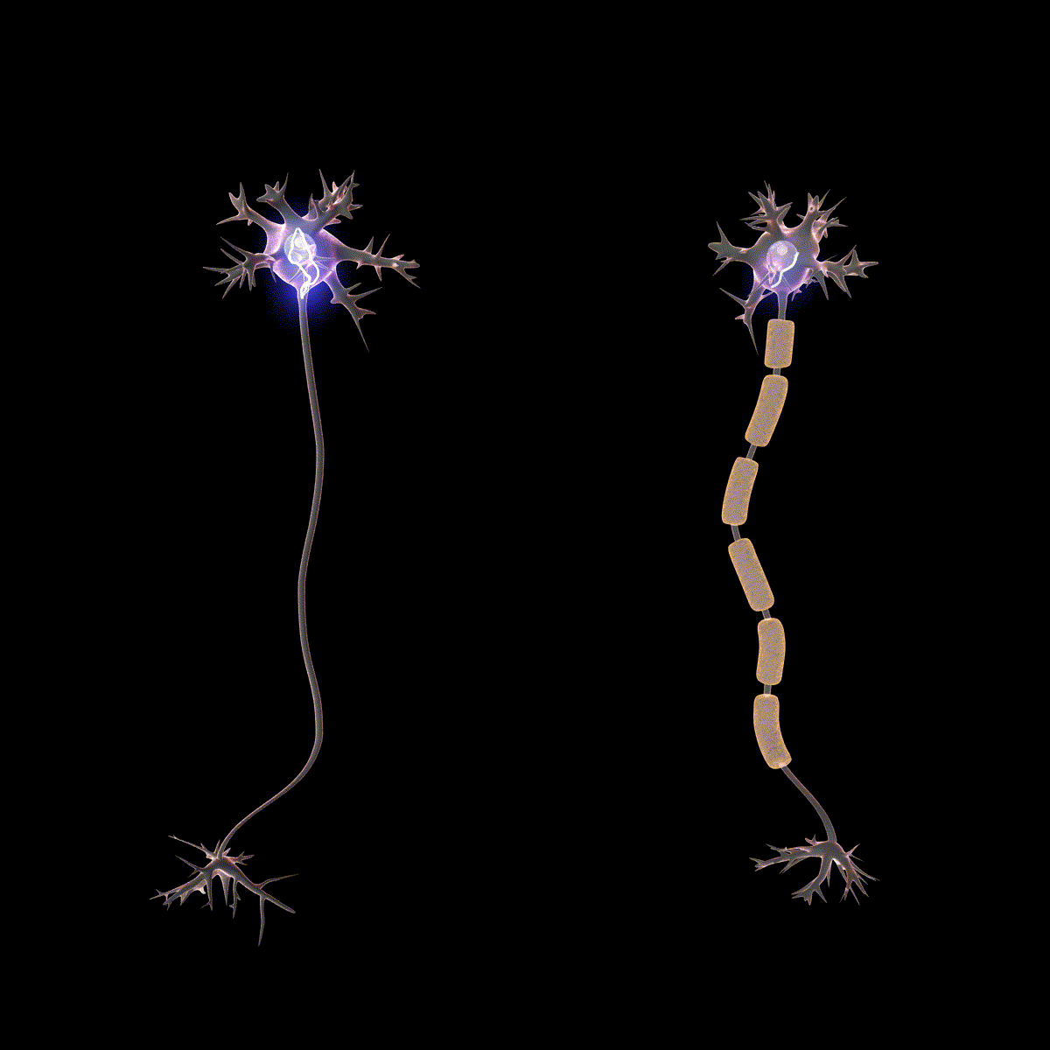
Biological Neural Networks
There are three classes of neurons:
Sensory neurons carry information from the sense organs (such as the eyes and ears) to the brain.
Motor neurons control voluntary muscle activity such as speaking and carry messages from nerve cells in the brain to the muscles.
All the other neurons are called interneurons.

Slide 97
Biological Neural Networks
As shown in the above diagram, a typical neuron consists of the following four parts with the help of which we can explain its working −
Dendrites − They are tree-like branches, responsible for receiving the information from other neurons it is connected to. In other sense, we can say that they are like the ears of neuron.
Soma − It is the cell body of the neuron and is responsible for processing of information, they have received from dendrites.
Axon − It is just like a cable through which neurons send the information.
Synapses − It is the connection between the axon and other neuron dendrites.

Slide 98
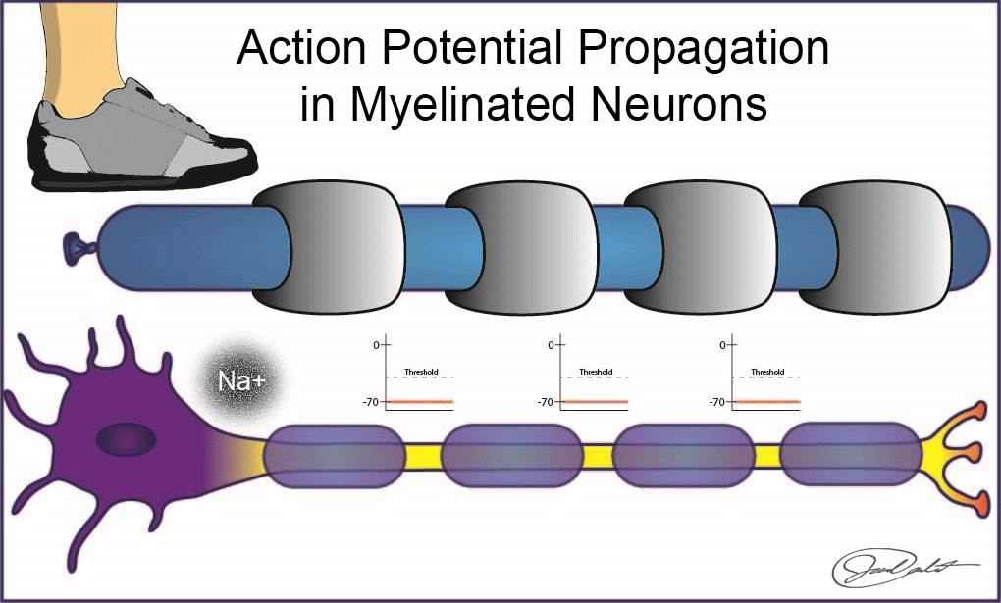
Biological Neural Networks

Slide 99
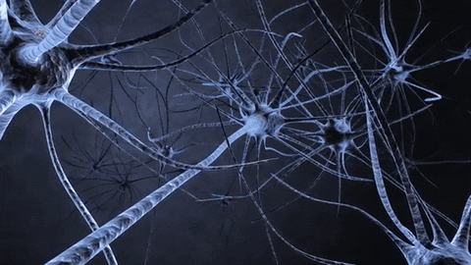
Biological Neural Networks
Biological Neural Network | Artificial Neural Network
Soma | Node
Dendrites | Input
Synapse | Weights or Interconnections
Axon | Output

Slide 100
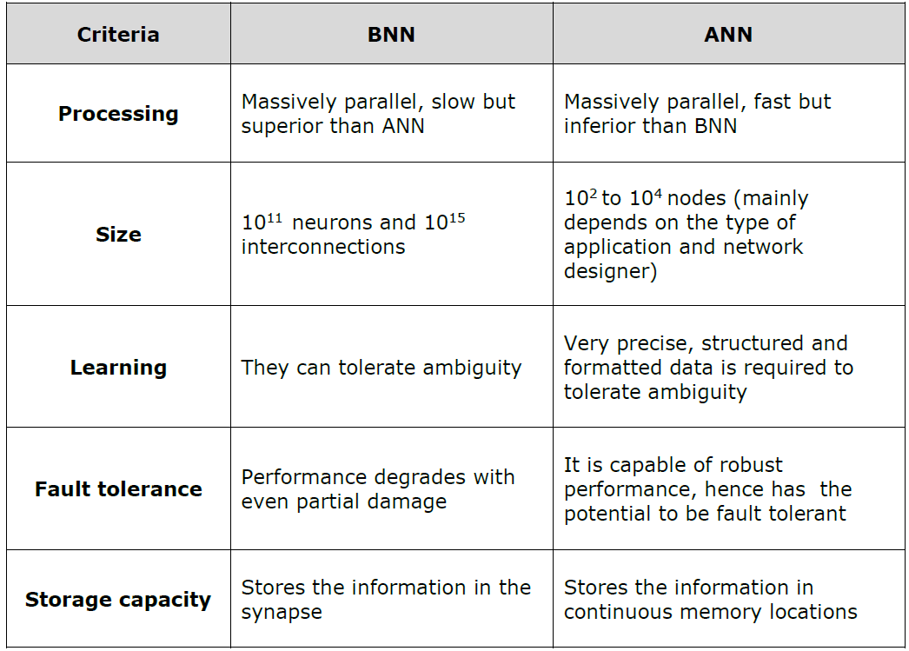
Biological Neural Networks
a

Slide 101

Artificial Neural Networks

Slide 102
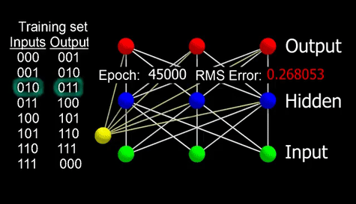
Artificial Neural Networks

Slide 103
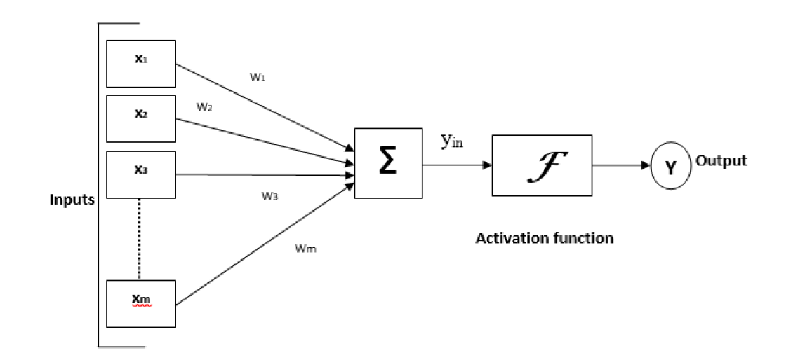
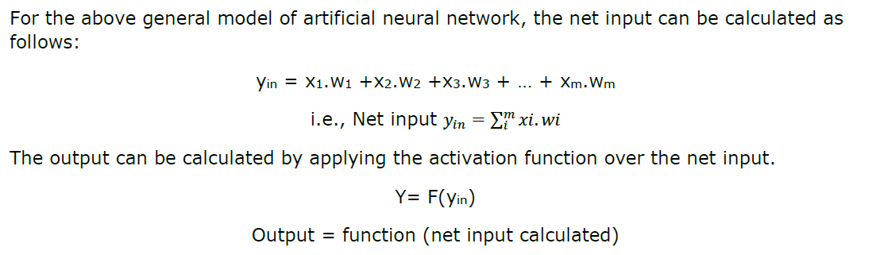
Model of ANN

Slide 104
Model of ANN
Characteristics of ANN:
It is a neutrally implemented mathematical model.
There exists a large number of highly interconnected processing elements called neurons in an ANN.
The interconnections with their weighted linkages hold the informative knowledge.
The input signals arrive at the processing elements through connections and connecting weights.
The processing elements of the ANN have the ability to learn, recall and generalize from the given data by suitable assignment or adjustment of weights.
The computational power can be demonstrated only by the collective behavior of neurons, and it should be noted that no single neuron carries specific information.

Slide 105
Underfitting and Overfitting
Underfitting
Underfitting occurs when a machine learning model is too simple to capture the underlying pattern of the data.
It means the model has poor performance on both the training data and the test data.
Characteristics:
High bias.
Low variance.
High training error.
High validation/test erro
e training data and the test data.

Slide 106
Underfitting and Overfitting
Causes Of Underfitting
The model is too simple (e.g., a linear model for non-linear data).
Insufficient training (not enough epochs for neural networks).
Incorrect features or lack of feature engineering.
Example: Using a linear regression model to fit data that has a quadratic relationship.
Solution:
Increase model complexity (e.g., use a more complex model or add more features).
Improve feature engineering.
Reduce regularization (if applied too strongly).

Slide 107
Underfitting and Overfitting
Overfitting
Definition:
Overfitting occurs when a machine learning model is too complex and captures the noise along with the underlying pattern in the data.
It means the model performs very well on the training data but poorly on the test data.
Characteristics:
Low bias.
High variance.
Low training error.
High validation/test error.

Slide 108
Underfitting and Overfitting
Causes Of Overfitting:
The model is too complex (e.g., too many parameters, too deep neural network).
Training for too many epochs.
Too few training examples relative to the model complexity.
Example: Using a high-degree polynomial regression model to fit data that has a linear relationship.
Solution:
Reduce model complexity (e.g., use fewer parameters or simpler model).
Increase the amount of training data.
Use regularization techniques (e.g., L1 or L2 regularization).
Apply cross-validation to tune model parameters.

Slide 109
Underfitting and Overfitting
Underfitting: Increase model complexity.
Overfitting: Reduce model complexity and use regularization techniques.
Goal: Achieve a balance between bias and variance to ensure the model generalizes well to unseen data.

Slide 110
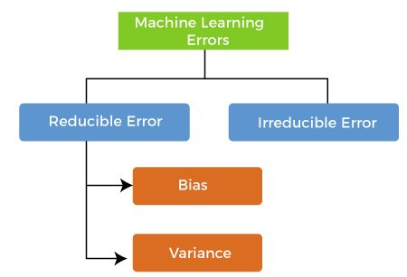
Bias And Variance
Errors in Machine Learning?
In machine learning, an error is a measure of how accurately an algorithm can make predictions for the previously unknown dataset. On the basis of these errors, the machine learning model is selected that can perform best on the particular dataset. There are mainly two types of errors in machine learning, which are:
Reducible errors: These errors can be reduced to improve the model accuracy. Such errors can further be classified into bias and Variance.
Irreducible errors: These errors will always be present in the model regardless of which algorithm has been used. The cause of these errors is unknown variables whose value can't be reduced.

Slide 111
Bias And Variance
Bias refers to the error introduced by approximating a real-world problem, which may be complex, by a much simpler model.
In machine learning, bias is an error due to overly simplistic assumptions in the learning algorithm.
Low Bias: A low bias model will make fewer assumptions about the form of the target function.
High Bias: A model with a high bias makes more assumptions, and the model becomes unable to capture the important features of our dataset. A high bias model also cannot perform well on new data.

Slide 112
Bias And Variance
Characteristics of High Bias:
High bias models tend to be too simple.
They fail to capture the complexity of the underlying data.
Result in high training error and high validation/test error, leading to underfitting.

Slide 113
Bias And Variance
Ways to reduce High Bias:
High bias mainly occurs due to a much simple model. Below are some ways to reduce the high bias:
Increase the input features as the model is underfitted.
Decrease the regularization term.
Use more complex models, such as including some polynomial features.

Slide 114
Bias And Variance
The variance would specify the amount of variation in the prediction if the different training data was used.
In simple words, variance tells that how much a random variable is different from its expected value.
Variance errors are either of low variance or high variance.
Low variance means there is a small variation in the prediction of the target function with changes in the training data set.
,High variance shows a large variation in the prediction of the target function with changes in the training dataset.

Slide 115
Bias And Variance
Ways to Reduce High Variance:
Reduce the input features or number of parameters as a model is overfitted.
Do not use a much complex model.
Increase the training data.
Increase the Regularization term.

Slide 116
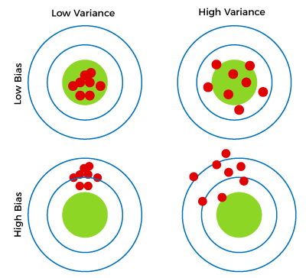
Bias And Variance
Different Combinations of Bias-Variance
There are four possible combinations of bias and variances, which are represented by the below diagram:

Slide 117
Bias And Variance
Low-Bias, Low-Variance: The combination of low bias and low variance shows an ideal machine learning model. However, it is not possible practically.
Low-Bias, High-Variance: With low bias and high variance, model predictions are inconsistent and accurate on average. This case occurs when the model learns with a large number of parameters and hence leads to an overfitting
High-Bias, Low-Variance: With High bias and low variance, predictions are consistent but inaccurate on average. This case occurs when a model does not learn well with the training dataset or uses few numbers of the parameter. It leads to underfitting problems in the model.
High-Bias, High-Variance: With high bias and high variance, predictions are inconsistent and also inaccurate on average.

Slide 118
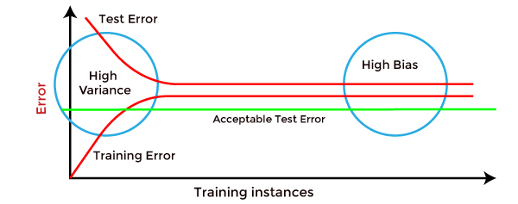
Bias And Variance
How to identify High variance or High Bias?
High variance can be identified if the model has:
Low training error and high test error.
High Bias can be identified if the model has:
High training error and the test error is almost similar to training error.

Slide 119
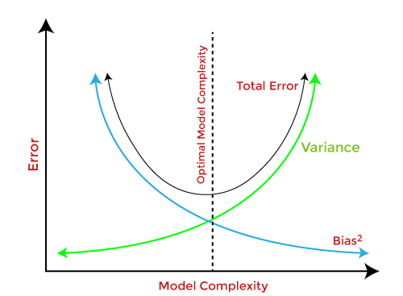
Bias And Variance
Bias-Variance Trade-Off
While building the machine learning model, it is really important to take care of bias and variance in order to avoid overfitting and underfitting in the model.
If the model is very simple with fewer parameters, it may have low variance and high bias. Whereas, if the model has a large number of parameters, it will have high variance and low bias.
So, it is required to make a balance between bias and variance errors, and this balance between the bias error and variance error is known as the Bias-Variance trade-off.

Slide 120
Bias And Variance
For an accurate prediction of the model, algorithms need a low variance and low bias. But this is not possible because bias and variance are related to each other:
If we decrease the variance, it will increase the bias.
If we decrease the bias, it will increase the variance.

Slide 121
Concept Learning Task
Concept Learning in Machine Learning can be thought of as a boolean-valued function defined over a large set of training data.
In order to complete the design of a learning algorithm, we need a learning mechanism or a good representation of the target concept.
Content:
Concept: The target function we aim to learn.
Hypothesis: A proposed explanation for the concept.
Instance: An example from the domain, often represented as a feature vector.
Label: The output value associated with an instance, often 0 or 1 in Boolean concepts.

Slide 122
Concept Learning Task
Taking a very simple example, one possible target concept may be to Find the day when my friend Ramesh enjoys his favorite sport. We have some attributes/features of the day like, Sky, Air Temperature, Humidity, Wind, Water, Forecast and based on this we have a target Concept named EnjoySport.
Example | Sky | AirTemp | Humidity | Wind | Water | Forecast | EnjoySport
1 | Sunny | Warm | Normal | Strong | Warm | Same | Yes
2 | Sunny | Warm | High | Strong | Warm | Same | Yes
3 | Rainy | Cold | High | Strong | Warm | Change | No
4 | Sunny | Warm | High | Strong | Cool | Change | Yes

Slide 123
Concept Learning Task
Let’s Design the problem formally with TPE(Task, Performance, Experience):
Problem: Leaning the day when Ramesh enjoys the sport.
Task T: Learn to predict the value of EnjoySport for an arbitrary day, based on the values of the attributes of the day.
Performance measure P: Total percent of days (EnjoySport) correctly predicted.
Training experience E: A set of days with given labels (EnjoySport: Yes/No)

Slide 124
Concept Learning Task
Let us take a very simple hypothesis representation which consists of a conjunction of constraints in the instance attributes. We get a hypothesis h_i with the help of example i for our training set as below:
hi(x) := <x1, x2, x3, x4, x5, x6>
where x1, x2, x3, x4, x5 and x6 are the values of Sky, AirTemp, Humidity, Wind, Water and Forecast.
Hence h1 will look like(the first row of the table above):
h1(x=1): <Sunny, Warm, Normal, Strong, Warm, Same > Note: x=1 represents a positive hypothesis / Positive example
We want to find the most suitable hypothesis which can represent the concept. For example, Ramesh enjoys his favorite sport only on cold days with high humidity (This seems independent of the values of the other attributes present in the training examples).
h(x=1) = <?, Cold, High, ?, ?, ?>
Here ? indicates that any value of the attribute is acceptable. Note: The most generic hypothesis will be < ?, ?, ?, ?, ?, ?> where every day is a positive example and the most specific hypothesis will be <?,?,?,?,?,? > where no day is a positive example.

Slide 125
Concept Learning Task
We will discuss the two most popular approaches to find a suitable hypothesis, they are:
Find-S Algorithm
List-Then-Eliminate Algorithm

Slide 126
Concept Learning Task(Find-S Algorithm)
Find-S Algorithm:
Following are the steps for the Find-S algorithm:
Initialize h to the most specific hypothesis in H
For each positive training example,
For each attribute, constraint ai in h
If the constraints ai is satisfied by x
Then do nothing
Else replace ai in h by the next more general constraint that is satisfied by x
Output hypothesis h

Slide 127
Concept Learning Task
The LIST-THEN-ELIMINATE Algorithm:
Following are the steps for the LIST-THE-ELIMINATE algorithm:
VersionSpace <- a list containing every hypothesis in H
For each training example, <x, c(x)>
Remove from VersionSpace any hypothesis h for which h(x) != c(x)
Output the list of hypotheses in VersionSpace.
Conclusion
The most suitable way to find a good hypothesis will be to start with both the directions, by taking the most general and the most specific boundaries. This approach is called a CANDIDATE-ELIMINATION Learning Algorithm. We will solve some nice examples in the next blog with all the help of the mentioned algorithms.

Slide 128
Version Space and Candidate Elimination Algorithm
What is Version Space?
Definition: The set of all hypotheses consistent with the training examples.
Purpose: Helps in identifying the best hypothesis by narrowing down the hypothesis space
Hypothesis Space and Version Space
Explanation of hypothesis space: All possible hypotheses.
Version space: Subset of hypothesis space consistent with training examples.

Slide 129
Candidate Elimination Algorithm
The candidate elimination algorithm incrementally builds the version space given a hypothesis space H and a set E of examples.
The examples are added one by one; each example possibly shrinks the version space by removing the hypotheses that are inconsistent with the example.
The candidate elimination algorithm does this by updating the general and specific boundary for each new example.
You can consider this as an extended form of the Find-S algorithm.
Consider both positive and negative examples.
Actually, positive examples are used here as the Find-S algorithm (Basically they are generalizing from the specification).
While the negative example is specified in the generalizing form.

Slide 130
Candidate Elimination Algorithm
Terms Used:
Concept learning: Concept learning is basically the learning task of the machine (Learn by Train data)
General Hypothesis: Not Specifying features to learn the machine.
G = {‘?’, ‘?’,’?’,’?’…}: Number of attributes
Specific Hypothesis: Specifying features to learn machine (Specific feature)
S= {‘pi’,’pi’,’pi’…}: The number of pi depends on a number of attributes.
Version Space: It is an intermediate of general hypothesis and Specific hypothesis. It not only just writes one hypothesis but a set of all possible hypotheses based on training data-set

Slide 131
Candidate Elimination Algorithm
Algorithm
Step1: Load Data set
Step2: Initialize General Hypothesis and Specific Hypothesis.
Step3: For each training example
Step4: If example is positive example
if attribute_value == hypothesis_value:
Do nothing
else: replace attribute value with '?’
(Basically generalizing it)
Step5: If example is Negative example Make generalize hypothesis more specific.

Slide 132
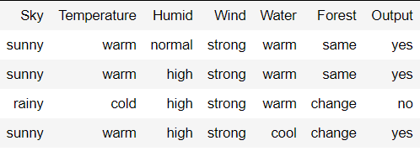
Candidate Elimination Algorithm
Example:
Consider the dataset given below:

Slide 133
Candidate Elimination Algorithm
Algorithmic steps:
Initially : G = [[?, ?, ?, ?, ?, ?], [?, ?, ?, ?, ?, ?], [?, ?, ?, ?, ?, ?], [?, ?, ?, ?, ?, ?], [?, ?, ?, ?, ?, ?], [?, ?, ?, ?, ?, ?]] S = [Null, Null, Null, Null, Null, Null]
For instance 1 : <'sunny','warm','normal','strong','warm ','same'> and positive output. G1 = G S1 = ['sunny','warm','normal','strong','warm ','same'] For instance 2 : <'sunny','warm','high','strong','warm ','same'> and positive output. G2 = G S2 = ['sunny','warm',?,'strong','warm ','same’]
For instance 3 : <'rainy','cold','high','strong','warm ','change'> and negative output. G3 = [['sunny', ?, ?, ?, ?, ?], [?, 'warm', ?, ?, ?, ?], [?, ?, ?, ?, ?, ?], [?, ?, ?, ?, ?, ?], [?, ?, ?, ?, ?, ?], [?, ?, ?, ?, ?, 'same']] S3 = S2
For instance 4 : <'sunny','warm','high','strong','cool','change'> and positive output. G4 = G3 S4 = ['sunny','warm',?,'strong', ?, ?]
At last, by synchronizing the G4 and S4 algorithm produce the output.
G = [['sunny', ?, ?, ?, ?, ?], [?, 'warm', ?, ?, ?, ?]] S = ['sunny','warm',?,'strong', ?, ?]

Slide 134
Inductive Bias
Inductive bias can be defined as the set of assumptions or biases that a learning algorithm employs to make predictions on unseen data based on its training data.
These assumptions are inherent in the algorithm’s design and serve as a foundation for learning and generalization.
The inductive bias of an algorithm influences how it selects a hypothesis (a possible explanation or model) from the hypothesis space (the set of all possible hypotheses) that best fits the training data.
It helps the algorithm navigate the trade-off between fitting the training data perfectly (overfitting) and generalizing well to unseen data (underfitting).

Slide 135
Inductive Bias
Types of Inductive Bias:
Inductive bias can manifest in various forms, depending on the algorithm and its underlying assumptions. Some common types of inductive bias include:
Bias towards simpler explanations: Many machine learning algorithms, such as decision trees and linear models, have a bias towards simpler hypotheses. They prefer explanations that are more parsimonious and less complex, as these are often more likely to generalize well to unseen data.
Bias towards smoother functions: Algorithms like kernel methods or Gaussian processes have a bias towards smoother functions. They assume that neighboring points in the input space should have similar outputs, leading to smooth decision boundaries.

Slide 136
Inductive Bias
Bias towards specific types of functions: Neural networks, for example, have a bias towards learning complex, nonlinear functions. This bias allows them to capture intricate patterns in the data but can also lead to overfitting if not regularized properly.
Bias towards sparsity: Some algorithms, like Lasso regression, have a bias towards sparsity. They prefer solutions where only a few features are relevant, which can improve interpretability and generalization

Slide 137
Inductive Bias
Importance of Inductive Bias
Inductive bias is crucial in machine learning as it helps algorithms generalize from limited training data to unseen data.
Without a well-defined inductive bias, algorithms may struggle to make accurate predictions or may overfit the training data, leading to poor performance on new data.
Understanding the inductive bias of an algorithm is essential for model selection, as different biases may be more suitable for different types of data or tasks.
It also provides insights into how the algorithm is learning and what assumptions it is making about the data, which can aid in interpreting its predictions and results.

Slide 138
Inductive Bias
Challenges and Considerations
While inductive bias is essential for learning, it can also introduce limitations and challenges.
Biases that are too strong or inappropriate for the data can lead to poor generalization or biased predictions.
Balancing bias with variance (the variability of predictions) is a key challenge in machine learning, requiring careful tuning and model selection.
Additionally, the choice of inductive bias can impact the interpretability of the model.
Simpler biases may lead to more interpretable models, while more complex biases may sacrifice interpretability for improved performance.

Slide 139
Issues in Machine Learning
Although machine learning is being used in every industry and helps organizations make more informed and data-driven choices that are more effective than classical methodologies, it still has so many problems that cannot be ignored.
Here are some common issues in Machine Learning that professionals face to inculcate ML skills and create an application from scratch.
Inadequate Training Data: The major issue that comes while using machine learning algorithms is the lack of quality as well as quantity of data. Data quality can be affected by some factors as follows:
Noisy Data- It is responsible for an inaccurate prediction that affects the decision as well as accuracy in classification tasks.
Incorrect data- It is also responsible for faulty programming and results obtained in machine learning models. Hence, incorrect data may affect the accuracy of the results also.
Generalizing of output data- Sometimes, it is also found that generalizing output data becomes complex, which results in comparatively poor future actions.

Slide 140
Issues in Machine Learning
2. Poor quality of data: Noisy data, incomplete data, inaccurate data, and unclean data lead to less accuracy in classification and low-quality results. Data quality can also be considered as a major common problem while processing machine learning algorithms.
3. Overfitting & Underfitting : Models perform well on training data but poorly on new data(Overfittng). Models are too simple and fail to capture underlying patterns(underfitting).
Methods to reduce overfitting:
Increase training data in a dataset.
Reduce model complexity by simplifying the model by selecting one with fewer parameters
Ridge Regularization and Lasso Regularization
Early stopping during the training phase
Reduce the noise
Reduce the number of attributes in training data.
Constraining the model.

Slide 141
Issues in Machine Learning
Methods to reduce Underfitting:
Increase model complexity
Remove noise from the data
Trained on increased and better features
Reduce the constraints
Increase the number of epochs to get better results.
4. Bias-Variance Tradeoff: Balancing model complexity and generalization.
Methods to remove Data Bias:
Research more for customer segmentation.
Be aware of your general use cases and potential outliers.
Combine inputs from multiple sources to ensure data diversity.
Include bias testing in the development process.
Analyze data regularly and keep tracking errors to resolve them easily.
Review the collected and annotated data.
Use multi-pass annotation such as sentiment analysis, content moderation, and intent recognition

Slide 142
Issues in Machine Learning
5. Feature Engineering: Selecting and transforming relevant features.
6. Hyperparameter Tuning: Finding optimal model parameters.
7. Model Interpretability: Understanding model decisions and explanations.
8. Class Imbalance: Dealing with unequal class distributions.
9. Adversarial Attacks: Protecting models from intentional data manipulation.
10. Ethics and Fairness: Ensuring models are unbiased and ethical.

Slide 143
Data Science Vs. Machine Learning and AI
Artificial Intelligence | Machine Learning | Data Science
Includes Machine Learning. | Subset of Artificial Intelligence. | Includes various Data Operations.
Artificial Intelligence combines large amounts of data through iterative processing and intelligent algorithms to help computers learn automatically. | Machine Learning uses efficient programs that can use data without being explicitly told to do so. | Data Science works by sourcing, cleaning, and processing data to extract meaning out of it for analytical purposes.
Some of the popular tools that AI uses are- 1. TensorFlow2. Scikit Learn 3. Keras | The popular tools that Machine Learning makes use of are-1. Amazon Lex2. IBM Watson Studio3. Microsoft Azure ML Studio | Some of the popular tools used by Data Science are-1. SAS2. Tableau3. Apache Spark4. MATLAB
Artificial Intelligence uses logic and decision trees. | Machine Learning uses statistical models. | Data Science deals with structured and unstructured data.
Chatbots, and Voice assistants are popular applications of AI. | Recommendation Systems such as Spotify, and Facial Recognition are popular examples. | Fraud Detection and Healthcare analysis are popular examples of Data Science.

Slide 144
Assignment 1:
1. Define Machine Learning. Discuss with examples why machine learning is important.
Discuss with examples some useful applications of machine learning.
Explain how some areas/disciplines that influenced the machine learning.
What do you mean by a well–posed learning problem? Explain the important features that are required to well–define a learning problem.
Define learning program for a given problem. Describe the following problems with respect to Tasks, Performance and Experience:
a. Checkers Learning Problems
b. Handwritten Recognition Problem
c. Robot Driving Learning Problem
6. Describe in detail all the steps involved in designing a learning system.
7. Discuss the perspective and issues in machine learning.
NOTE: All Students have to write this assignment in separate note book.

Slide 145
Assignment 2:
What is Artificial Neural Network?
What are the type of problems in which Artificial Neural Network can be applied?
What is difference between BNN and ANN ?
Explain the k-Means Algorithm with an example.
What is Reinforcement Learning? Explain with the help of example.
Explain Bayesian networks with the help of Examples.
Explain Support Vector Machine in details. Describe their importance.
Explain Genetic Algorithms in details.

Slide 146
Daily Quiz
1. What is the main task of a problem-solving agent? a) Solve the given problem and reach to goal b) To find out which sequence of action will get it to the goal state c) All of the mentioned d) None of the mentioned
2. What is state space? a) The whole problem b) Your Definition to a problem c) Problem you design d) Representing your problem with variable and parameter

Slide 147
Daily Quiz
3. The problem-solving agent with several immediate options of unknown value can decide what to do by just examining different possible sequences of actions that lead to states of known value, and then choosing the best sequence. This process of looking for such a sequence is called Search. a) True b) False
4. A search algorithm takes _________ as an input and returns ________ as an output. a) Input, output b) Problem, solution c) Solution, problem d) Parameters, sequence of actions

Slide 148
Daily Quiz
5. A problem in a search space is defined by one of these state. a) Initial state b) Last state c) Intermediate state d) All of the mentioned
6. The Set of actions for a problem in a state space is formulated by a ___________ a) Intermediate states b) Initial state c) Successor function, which takes current action and returns next immediate state d) None of the mentioned

Slide 149
Glossary Questions
1. A solution to a problem is a ……………from the initial state to a goal state. Solution quality is measured by the path cost function, and an optimal solution has the highest path cost among all solutions. a) Path b) Road 2. The process of removing detail from a given state representation is called ______ a) Extraction b) Abstraction c) Information Retrieval d) Mining of data

Slide 150
Glossary Questions
3. A problem solving approach works well for ______________ a) 8-Puzzle problem b) 8-queen problem c) Finding a optimal path from a given source to a destination d) Mars Hover (Robot Navigation) 4. The _______ is a touring problem in which each city must be visited exactly once. The aim is to find the shortest tour. a) Finding shortest path between a source and a destination b) Travelling Salesman problem c) Map coloring problem d) Depth first search traversal on a given map represented as a graph

Slide 151
MCQ
1. Web Crawler is a/an ____________ a) Intelligent goal-based agent b) Problem-solving agent c) Simple reflex agent d) Model based agent 2. What is the major component/components for measuring the performance of problem solving? a) Completeness b) Optimality c) Time and Space complexity d) All of the mentioned

Slide 152
MCQ
3. A production rule consists of ____________ a) A set of Rule b) A sequence of steps c) Set of Rule & sequence of steps d) Arbitrary representation to problem 4. Which search method takes less memory? a) Depth-First Search b) Breadth-First search c) Linear Search d) Optimal search

Slide 153
MCQ
5. Which is the best way to go for Game playing problem? a) Linear approach b) Heuristic approach (Some knowledge is stored) c) Random approach d) An Optimal approach 6. Which of the following applications include in the Strategic Computing Program? a) battle management b) autonomous systems c) pilot’s associate d) all of the mentioned

Slide 154
MCQ
7. How many things are concerned in the design of a learning element? a) 1 b) 2 c) 3 d) 4 8. What is used in determining the nature of the learning problem? a) Environment b) Feedback c) Problem d) All of the mentioned

Slide 155
MCQ
9. How many types are available in machine learning? a) 1 b) 2 c) 3 d) 4 10. Which is used for utility functions in game playing algorithm? a) Linear polynomial b) Weighted polynomial c) Polynomial d) Linear weighted polynomial

Slide 156
Faculty Video Links, Youtube & NPTEL Video Links and Online Courses Details
Youtube video-
https://www.youtube.com/watch?v=PDYfCkLY_DE
https://www.youtube.com/watch?v=ncOirIPHTOw
https://www.youtube.com/watch?v=cW03t3aZkmE

Slide 157
Weekly Assignment
Assignment 1
Describe Machine Learning with suitable examples.[CO1]
Brief the well defined learning problems. [CO1]
Define the process of Designing a Learning System? [CO1]
Explain different perspective and Issues in Machine Learning. [CO1]
Define hypotheses. [CO1]
Analyze THE CONCEPT LEARNING TASK - General-to-specific ordering of hypotheses? [CO1]
Illustrate Find-S algorithm. [CO1]
Describe List-Then-Eliminate algorithm. [CO1]
Define Candidate elimination algorithm with example. [CO1]
Briefly explain Inductive bias. [CO1]

Slide 158
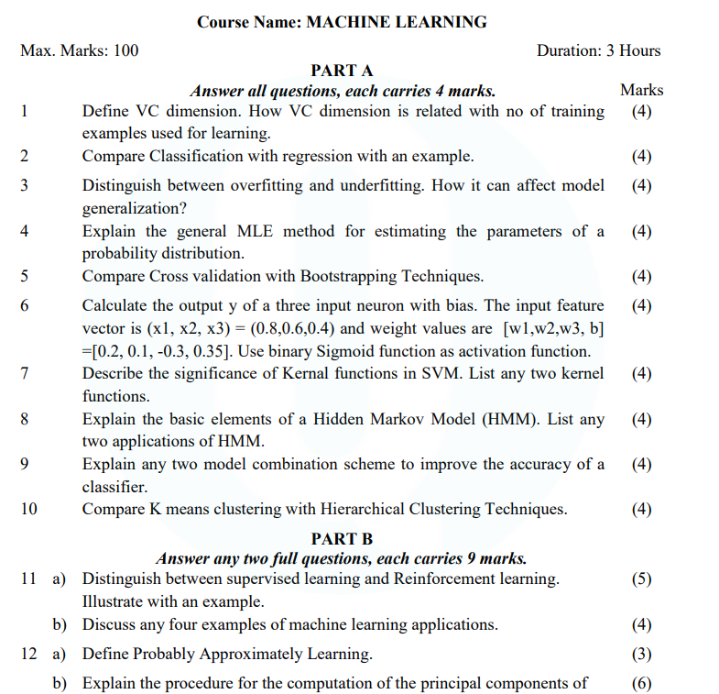
Old Question Papers

Slide 159
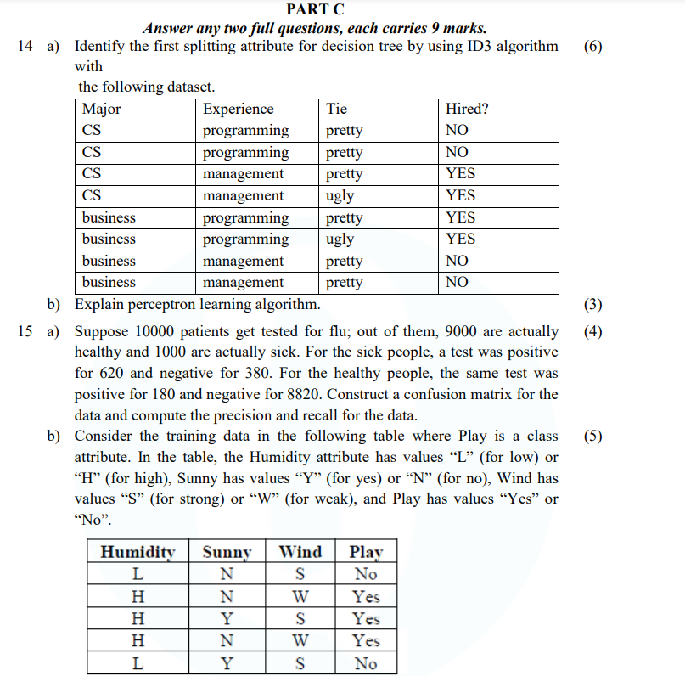
Old Question Papers

Slide 160
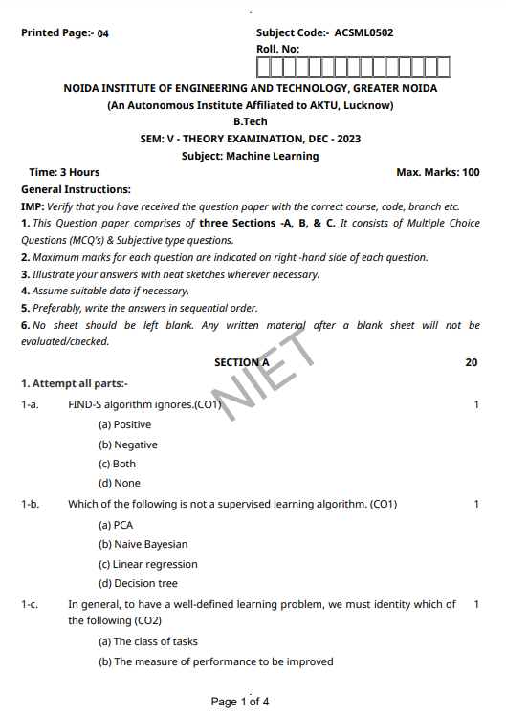
Old Question Papers

Slide 161
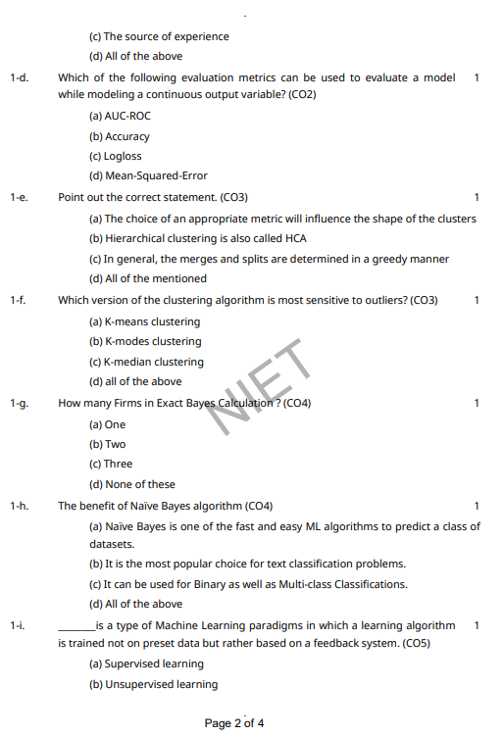
Old Question Papers

Slide 162
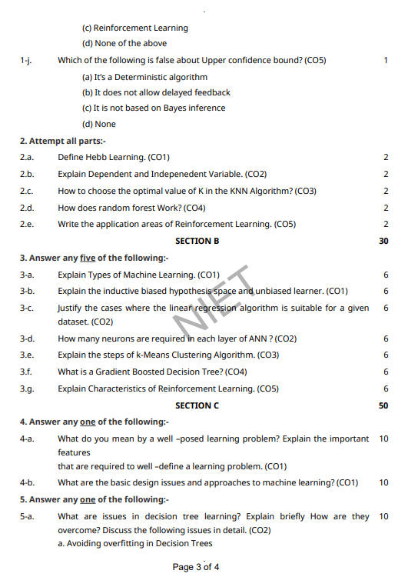
Old Question Papers

Slide 163
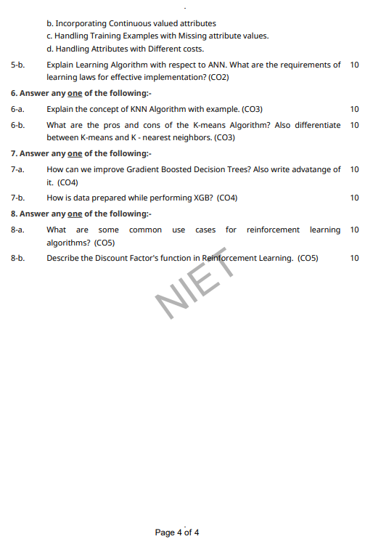
Old Question Papers

Slide 164
Expected Questions for University Exam
Illustrate Find-S algorithm. [CO1]
Describe List-Then-Eliminate algorithm. [CO1]
Define Candidate elimination algorithm with example. [CO1]
Briefly explain Inductive bias. [CO1]
Describe Machine Learning with suitable examples.[CO1]
Brief the well defined learning problems. [CO1]
Define the process of Designing a Learning System? [CO1]
Explain different perspective and Issues in Machine Learning. [CO1]
Define hypotheses. [CO1]
Analyze THE CONCEPT LEARNING TASK - General-to-specific ordering of hypotheses? [CO1]

Slide 165
References
Text books:
1. Tom M. Mitchell, ―Machine Learning, McGraw-Hill Education (India) Private Limited, 2013.
2. Ethem Alpaydin, ―Introduction to Machine Learning (Adaptive Computation and Machine Learning), The MIT Press 2004.
3. Stephen Marsland, ―Machine Learning: An Algorithmic Perspective, CRC Press, 2009.
4. Bishop, C., Pattern Recognition and Machine Learning. Berlin: Springer-Verlag.

Slide 166
Recap of Unit
Concept learning can be seen as a problem of searching through a large predefined space of potential hypotheses.
The general-to-specific partial ordering of hypotheses provides a useful structure for organizing the search through the hypothesis space.
The FIND-S algorithm utilizes this general-to-specific ordering, performing a specific-to-general search through the hypothesis space along one branch of the partial ordering, to find the most specific hypothesis consistent with the training examples.

